Slide 1
Amity Institute of Behavioural Health and Allied Sciences (AIBHAS)
Amity University, Uttar Pradesh
SEMINAR
Frontal Lobe Syndromes:
Clinical Features and Assessment
Vidushi Duggal
M.Phil. Clinical Psychology (II year)
DATE: 30th August 2019
CHAIR: Ms. Swasti Bansal

Slide 2
OVERVIEW
INTRODUCTION
  The cerebral cortex
  Frontal lobe features & anatomy
  Functions of the frontal lobe
FRONTAL LOBE SYNDROME
  What is frontal lobe syndrome?
  Etiology
  Clinical features & assessments
  Limitations of assessments
  Prognosis of FLS

Slide 3
INTRODUCTION
THE CEREBRAL CORTEX

Slide 4
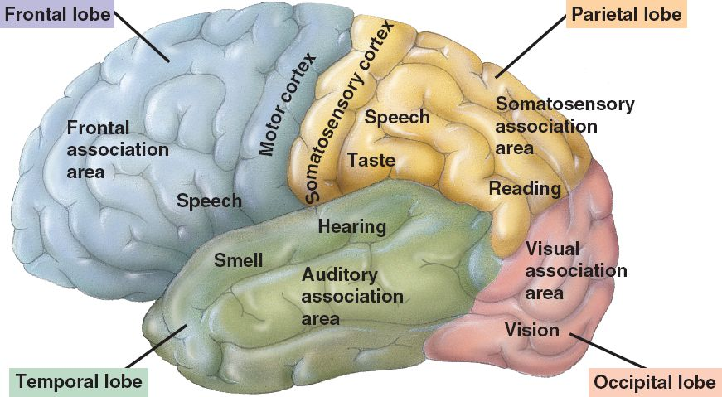
THE CEREBRAL CORTEX
Notes:
Superficial or outer layer of the brain; makes up 83% of its mass. Constitutes what is known as the grey matter and is responsible for higher order functions.

Slide 5
FRONTAL LOBE | PARIETAL LOBE
Motor planning and movement Expressive speech Cognition and executive functioning Personality, behaviour and emotions Self-awareness and regulation | Somatosensory perception Visuospatial perception Visuomotor coordination Body awareness Arithmetic, reading, writing and drawing
TEMPORAL LOBE | OCCIPITAL LOBE
Auditory perception and processing Learning and memory Receptive speech Emotional processing | Visual perception and processing Color recognition and discrimination Movement identification
Notes:
Body awareness – identifying location, position and movement of body parts.

Slide 6
INTRODUCTION
FRONTAL LOBE FEATURES & ANATOMY

Slide 7
The most recently developed of the four lobes and comprises about one-third of the cerebral cortex (Goldman-Rakic, 1987).
Regarded as the cortical locus of ‘higher learning’ and the structure that defines the self (Goldstein, 1936 & Halstead, 1947).
Several areas that are anatomically and functionally distinguishable; divided in a number of ways.
Major divisions (Martin, 2006):
    Precentral area
    Premotor area
    Prefrontal area – orbitofrontal and dorsolateral

Slide 8
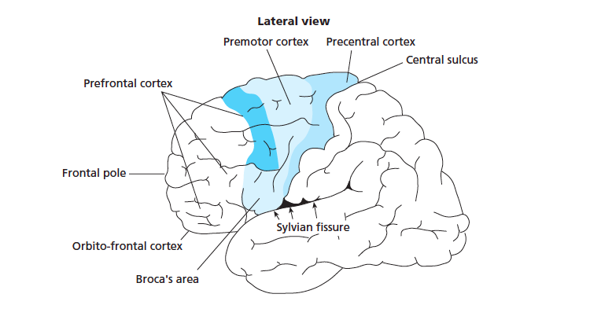

Slide 9
Precentral area
  contains the motor cortex
  responsible for making movements
Premotor area
  supplementary motor area or M-II, selection of movements
  frontal eye field, controls aspects of eye movement
  Broca’s area, controls the production of voluntary speech

Slide 10
Prefrontal area
  Controls cognitive processes so that appropriate movements are selected at the correct time and place.
  Involved in maintenance and execution of abstract thought, reasoning and inhibition of responses.

Slide 11
FRONTAL LOBE
FUNCTIONS

Slide 12
Multiplicity and complexity of functions, such that they seem
to impinge on the whole repertoire of behaviour – from movement planning and motor movement to social behaviour and personality.
Described as the brain’s ‘orchestra leader’ that directs the activity of other sensory, motor and cognitive systems and coordinates inputs to and outputs from all major association sensory areas of the cortex and the limbic system.
Notes:
REASON: structurally connected to all major cortical and subcortical regions; majority of the brain activity is mediated via the frontal lobe

Slide 13
FRONTAL LOBE
MOTOR
SPEECH & LANGUAGE
COGNITIVE
& EXECUTIVE FUNCTIONING
PERSONALITY
& BEHAVIOUR
SENSORY-
PERCEPTUAL JUDGEMENT

Slide 14
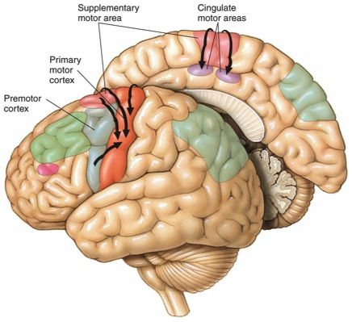
MOTOR FUNCTIONS (premotor & motor cortex)
  Voluntary movement programming – planning, preparation and selection
  of movements
  Fine movements – speed and
  strength
  Voluntary eye gaze
  Corollary discharge – transmission
  of information from one brain region
  to the other so that the one informs
  the other of its intended action

Slide 15
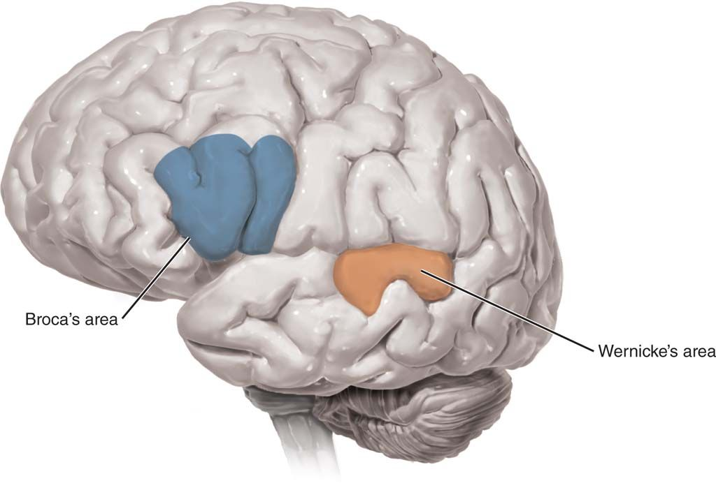
SPEECH & LANGUAGE FUNCTIONS (BROCA’S AREA)
  Production of speech
  and verbal expression
  Written expression

Slide 16
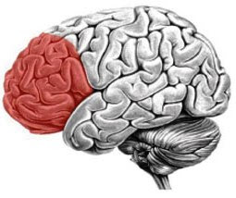
COGNITIVE & EXECUTIVE FUNCTIONS (prefrontal cortex)
  Attention & concentration
  Working memory
  Intelligence
  Creativity
  Higher order executive functions

Slide 17
Higher order executive functions – essential for planning, making goals,
and regulating and verifying behaviour:
  Planning
  Organization
  Initiation
  Reasoning
  Judgement
  Decision-making
  Abstract thinking
  Problem solving
  Sequencing
  Set-shifting/cognitive flexibility
Notes:
ability to guide its behaviour by internal representations and also to ‘‘switch gears’’ when something unanticipated happens [3]. To deal with such transitions effectively, a particular ability is needed - mental flexibility, that is, the capacity to respond rapidly to unanticipated environmental contingencies. Sometimes this capacity is referred to as the ability to shift cognitive set.

Slide 18
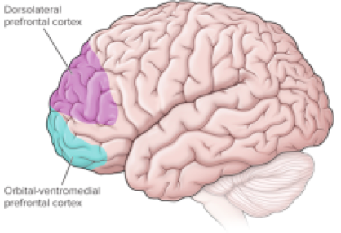
PERSONALITY & behavior (PREFRONTAL CORTEX)
Personality traits
Autonoetic awareness
Emotional regulation
& expression
Self-regulation & impulse control
Theory of mind
Social behaviour
Sexual behaviour
Notes:
Emotional regulation & expression – INCLUDING MOOD AND AFFECT
Refers to autobiographical knowledge.
According to Tulving, autonoetic awareness makes it possible to
bind together the awareness of oneself as a continuous entity through time.

Slide 19
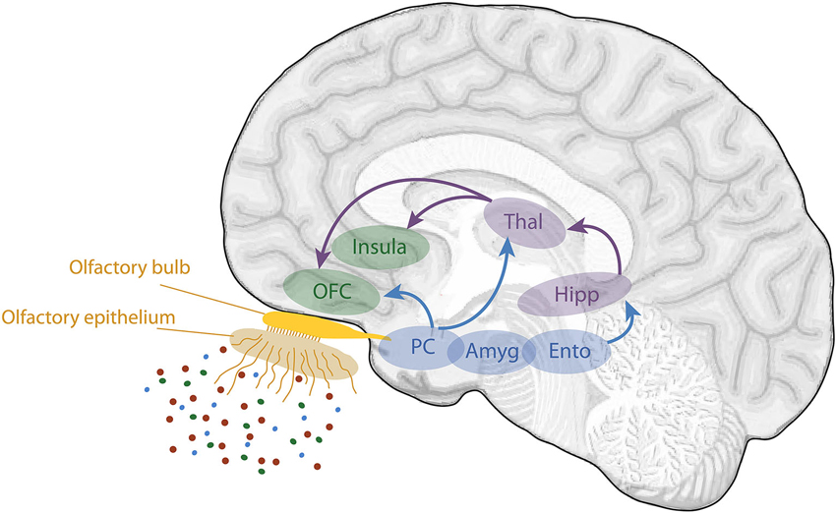
SENSORY-PERCEPTUAL JUDGEMENT (ofc)
Odour memory
Odour discrimination
Flavour perception
Affective value of food
and food reward
(Small et al., 2007)

Slide 20
FRONTAL LOBE SYNDROME
WHAT IS FRONTAL LOBE SYNDROME?

Slide 21
Neuropsychological consequences of frontal lobe injury have been characterized as a syndrome, i.e., a cluster of behavioural symptoms that reliably appear.
Refers to a clinical syndrome resulting from damage and impaired function of the frontal cortex resulting in the damage of higher functioning processes of the brain such as motivation, planning, social behaviour and language/speech production (Pirau & Lui, 2018).
Because these deficits cannot be subclassified, the term frontal lobe syndrome is used to refer to an amorphous, varied group of deficits resulting from diverse etiologies, different locations and variable extents of abnormalities (Stuss & Benson, 1984).

Slide 22
  Considerable variation in the types and manifestation of symptoms.
  All frontal lobe patients do no show all symptoms; variation in severity.
  Symptom presentation is complicated by the specific region and hemisphere of the prefrontal cortex damage.
  Variable test performance between individuals with frontal damage.

Slide 23
Broad categories of symptoms:
  Motor symptoms – damage to premotor and precentral cortex
  (motor strip)
  Sensory-perceptual symptoms – damage to orbitofrontal cortex
  Speech & language symptoms – Broca’s area
  Cognitive symptoms – damage to dorsolateral prefrontal cortex
  Personality changes and behavioural & emotional symptoms –
  damage to orbitofrontal cortex
Notes:
relate to the broad functions of the FL
no singular clinical presentation
any number and combination of these symptoms may appear in a person with frontal lobe damage depending on

Slide 24
FRONTAL LOBE SYNDROME
ETIOLOGY

Slide 25
Closed-head trauma
Neurodegenerative disease (dementias)
Tumours compressing the frontal lobe
Stroke
Epilepsy with frontal lobe foci
HIV
Multiple sclerosis

Slide 26
FRONTAL LOBE SYNDROME
CLINICAL FEATURES & ASSESSMENT

Slide 27
MOTOR SYMPTOMS
Impairment in movement programming
  Difficulty planning, preparing and selecting movements.
  Difficulty serially ordering complex chains of behaviour
  in relation to varying stimuli.
  Inability to undertake a behaviour or response in a particular order (Luria, 1966) – a disintegration in learned sequential actions such that learned behaviour had become ‘series of isolated fragments’.
  Buccofacial apraxia – difficulty copying simple gestures
  (Kolb and Milner, 1981)
Notes:
Apraxia – difficulty in motor planning to perform tasks; despite having the desire and physical capability to carry it out.
Patients with left and right frontal lobe damage were poor at copying a series of facial (but not arm) movements, making more errors of sequence than did controls and other patients
E.g. cooking

Slide 28
Impaired corollary discharge (Teuber & Mishkin, 1954).
  For a movement to take place:
    a neural signal must produce the movement
    a signal that the movement is going to take place
  A person’s sensory system can interpret changes in the external world in light of information about his or her movement. E.g. running
  A frontal lesion can therefore not only disturb production of movement, but also interfere with the message to the rest of
  the brain that a movement is taking place.
Notes:
Intended eye movement. CD sent before the eyes actually move, Get info about eye movement before it happens, helps prepare and interpret the movement.

Slide 29
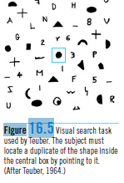
Impairment in fine movement
  chronic loss of the ability of to
  make fine, independent movements
  in the hands, fingers and face
  reduction in fine motor speed
  and strength
Poor voluntary eye gaze
  Disorganized visual scanning
  and search (Luria, 1973).
Notes:
Task- recorded patients’ eye movements as they examined a picture of a complex scene.
Normal subjects- if asked about age of the people in a picture, eyes were fixed on the heads; if asked about dressing,eyes fixed on the clothing
Large frontal lobe lesions
glance over the picture more or less at random
change in the question about the picture failed to alter the direction or the pattern of eye movements.
Teuber presented patients with an array of 48 patterns on a screen. The patterns could be distinguished by shape or color or both (Figure 16.5). At a warning signal, a duplicate of one of the 48 patterns appeared in the center of the array, and the subject’s task was to identify the matching pattern by pointing to it. Patients with frontal-lobe lesions were impaired at finding the duplicate pattern.

Slide 30
Compulsive repetition or perseveration of an initiated action
  When lesion extends to the basal ganglia
  May be present in motor acts, speech/verbalization, drawing, writing, etc.
Dysfunctional reflexes
  Involuntary resistance to movement
  Involuntary grasp of an object placed on the hand despite conscious attempts
Changes/abnormalities in gait.
Notes:
When asked to copy a circle, the movement is completed correctly but cannot be inhibited; a series of repetitive circular movements ensue.
Abnormal repetition of a specific behaviour.

Slide 31
ASSESSMENT OF MOTOR FUNCTION
Hand Dynamometry/Grip Strength
    Assesses motor strength.
Finger Tapping
    Assesses motor speed.
Facial Sequence Test
    Assesses motor sequencing.

Slide 32
Bender Visual Motor Gestalt Test
    Visuomotor integration
    Fine motor skills
Finger gaze test
    Assesses voluntary eye gaze.
To test for apraxia – simple tasks such as making certain facial gestures or demonstrating the use of an object (e.g. toothbrush, comb)

Slide 33
SENSORY-PERCEPTUAL SYMPTOMS
Disturbance in the perception of taste and smell (Martin, 2004).
Gustatory disturbance
  Disturbance in the perception and mediation of food flavour
  (Martin, 2004).
Olfactory disturbance:
  Damage to the orbitofrontal, as well as right temporal cortices results in impaired odour memory (Jones-Gotman & Zatorre, 1993).
  Difficulty in discriminating between odours.

Slide 34
SPEECH AND LANGUAGE SYMPTOMS
Broca’s aphasia
  associated with lesions in Broca’s area
  non-fluent speech (sparse, effortful, dysarthric, dysprosodic,
  and agrammatic)
  poor repetition
  relatively good comprehension
  difficulty with word naming, reading, and writing
Notes:
Aphasia – an acquired loss of or deficit in speech/language; brain damage; both expressive and receptive language
Dysarthria often is characterized by slurred or slow speech that can be difficult to understand.
Dysprosody, which may manifest as pseudo-foreign accent syndrome, refers to a disorder in which one or more of the prosodic functions are either compromised or eliminated completely. Prosody refers to the variations in melody, intonation, pauses, stresses, intensity, vocal quality, and accents of speech.

Slide 35
Transcortical Motor Aphasia
  associated with left-hemisphere lesions in medial frontal cortex (supplementary motor area)
  an inability to initiate spontaneous speech and writing
  repetition is comparatively intact
  comprehension intact
Aphemia
  an apraxia of speech; isolated disorder of coordinated speech articulation
  characterized by complete articulatory failure in the presence of preserved comprehension and writing.
Notes:
an isolated disorder of coordinated speech articulation that results in severe affection of verbal motor output

Slide 36
Agrammatism – inability to use verbs and produce appropriate grammar.
The ability to maintain a sequence, either verbal or nonverbal also affects the comprehension of language (Albert, 1972). Thus, many patients with frontal pathology will comprehend individual words well, but if given
a sequence of words, will appear to comprehend only a few (either the first or the last).
Loss of the regulatory power of language (Luria, 1966). Thus,
frontal patients may verbalize a task correctly but cannot use
the verbalization to direct behavior.
  .

Slide 37
ASSESSMENT OF SPEECH/LANGUAGE FUNCTION
Boston Naming Test
  Assesses word retrieval and naming.
Expressive Vocabulary Test
  Assesses expressive vocabulary and word retrieval.
Token Test
  Assesses verbal comprehension.
Notes:
Boston Naming Test – name objects from pictures/line drawings
EVT – 152 synonym items and 38 labeling items which require subject to name the picture or body part
Token Test – presented with 20 tokens that vary in shape, size and color . Given 62 oral commands to follow – place white square beneath the red circle.

Slide 38
Western Aphasia Battery
  Assesses different types of aphasias.
Boston Diagnostic Aphasia Battery
  Assesses different types of aphasias, verbal comprehension and writing.
  .
Notes:
WAB – uses four oral language subtests. Also has tests for reading, writing, calculation and nonverbal skill
BDAB – qualitative assessment of language difficulties

Slide 39
COGNITIVE SYMPTOMS
    Attention & concentration
    Memory
    Utilization behavior
    Associative learning
    Planning, sequencing, strategy formation and goal formulation
    Rule deduction and rule following
    Decision-making
    Response initiation and suppression
    Abstract thinking
    Cognitive flexibility
    Problem solving
Notes:
Overall impairment in all of these domains.

Slide 40
Attention & Concentration
Difficulty with selective attention.
Frontal lobe patients appear to have impaired attentional capacity
in that they show poor concentration and are highly distractible (Mesulam 1986; Janowsky et al. 1989).
Notes:
Selective attention – perceive and analyse data from one source of information while excluding other irrelevant or interfering sources of information.
However, Duncan and his colleagues (Duncan, 1995; Duncan et al. 1995) propose that
frontal lobe function is related to intelligence but not to conventional, general intelligence,
or g. Instead, Duncan proposes that the frontal lobes might be involved in the
execution of tests of fluid intelligence: that is, tests that do not require the subject to use
prior information explicitly

Slide 41
Memory
Baddeley (1986) has characterized frontal (specifically, prefrontal) dysfunction as a ‘dysexecutive’ syndrome involving the disruption
of working memory.
Baddeley suggested that the impairments seen after frontal damage are malfunctions of the central executive, which is a component of working memory and is thought to control resources and monitor information processing.
Frontal lobe patients exhibit memory deficits on tasks of free recall, interference and working memory (Martin, 2006).
Notes:
The most important part of working memory is the central executive, which is thought to control resources and monitor information processing. It is served by two other processes, the phonological loop, which stores and rehearses verbal information, and the visuospatial sketchpad, which is concerned with visuospatial information and imagery. An example of the type of operation carried out by working memory is finding a number in the telephone directory and holding it in mental space until the number is dialled.

Slide 42
Inability to retrieve episodic memories despite intact semantic retrieval (Wheeler & Stuss, 2003). Claim to know this information,
but are unable to remember it, suggesting that such patients have
an ‘impoverished ability’ to recollect past autobiographical events consciously.
Difficulty with “prospective memory”: remembering to perform an activity in the future (Maylor, 1996).
Notes:
It is our hypothesis that patients with frontal lobe damage have an impoverished ability to consciously recollect the past, even when they know about their past, and that such a deficit is related to other problems, such as failures of self-awareness and insight. seem unwilling or unable to become intimately aware of their prior experiences, despite good knowledge about the experiences.
recall “facts of memory”, yet without the self-continuity that would be expected of people who were recollecting their own past. The patients were said to have a detached attitude about things that had happened to them, and would often discuss incidents from their past as if they were describing someone else. Squire (1987) associated frontal pathology with a loss of “personal familiarity and connectedness” to recent events that could be recalled or recognized. There is also evidence that such patients can readily update their knowledge (i.e., learn from the past), yet fail to recollect the source of their knowledge
In time-based experiments, the participant engages in a task and has to inform the experimenter when a certain time has elapsed (Einstein et al. 1998). This may be analogous to remembering to telephone someone in an hour’s time (Maylor 1996). In event-based experiments, participants must make a response when a particular event occurs in a sequence of events. Fortin et al. (2003) examined the effect of confirmed or suspected frontal lobe damage on the execution of what they call daily living scripts: ‘mental’ schemata that outline the steps in a task, such as preparing a meal. Whereas there was no difference between the patient and control group when each had to prepare a menu, the frontal lobe group was significantly impaired at meal preparation and poor at grocery shopping.

Slide 43
Utilization Behaviour
Unilateral or bilateral lesions.
Utilization behaviour (UB) describes a behavioural disturbance in which the patient uses objects, prompted or unprompted, in his or her environment.
Two types of UB have been identified (Shallice et al. 1989).
  ‘Induced’ UB – where the others’ (e.g. experimenter’s) comportment appears to prompt the use of objects (Lhermitte 1983).
  Incidental UB – describes behaviour where the patient uses objects nearby when performing other tasks.
Notes:
Comportment – behaviour/bearing
Appropriate use of an object in an inappropriate situation.
Induced - For example, when shown a pair of glasses, a patient is likely to put on the glasses.
Incidental – the patient will use an object if it catches his attention, whether relevant or not.

Slide 44
According to Lhermitte et al. (1986), frontal lobe patients may also exhibit imitation behaviour (IB), i.e. they imitate the examiner’s gestures even though they are instructed not to. This behaviour precedes UB.
The sight of the movement is perceived in the patient’s mind as
an order to imitate.
Similarly in UB, the sight of an object implies the order to use it.
Notes:
difficulty resisting the impulse to operate or manipulate objects which are in their visual field and within reach

Slide 45
At the cortical level, UB is the result of impaired inhibitory action of the frontal lobe on the parietal lobe (Lhermitte,1983).
Sensory information – integration by parietal lobe – frontal lobe inhibition of parietal activity = relative dependence or independence from the external environment = suitable response
Frontal lobe patients are thought to have ‘released’ parietal lobe activity, which leaves the patient exposed to all external stimuli.
Notes:
In normal individuals, the parietal lobe integrates sensory information from the environment, while the frontal lobe inhibits some of the parietal lobe’s activity. This relationship ensures the relative dependence on or independence from the external environment, making sure that the quality of external stimuli is examined.

Slide 46
Learning
Impaired associative learning.
Unable to regulate behaviour in response to external stimuli or learn from experience.
Luria and Homskaya (1964) described patients with massive frontal-lobe tumors who could not be trained to respond consistently with
the right hand to a red light and with the left hand to a green light,
even though the patients could indicate which hand was which and
could repeat the instructions.

Slide 47
  Rule deduction and rule following
  Frequently noticed in frontal-damaged patients when they make perseverations (especially if they repeatedly use the same rules),
  or use inappropriate rules.
  The nature of impairment on such complex tasks remains unclear
  and may involve the failure to identify rules, inability to use
  feedback and inflexibility in switching cognitive sets
  Evidenced by poor performance on Wisconsin Card Sorting Test.

Slide 48
  Shallice and Burgesse (1991) study:
  Task: list of six errands (buy a loaf of bread, etc.) + get answers to four questions (price of a pound of tomatoes) + regroup at a given location
  in 15 min.
  Instruction: complete tasks as quickly without rushing + not to enter
  any unnecessary shops
  Results: frontal lobe patients found to be inefficient; broke rules
  (e.g. entered unnecessary shops). Yet, when quizzed all patients
  understood the tasks and attempted to comply.

Slide 49
Inability to follow rules or use knowledge of incorrect performance to alter behaviour, despite being able to understand and repeat rules if asked verbally (Benton, Elithorn, Fogel, & Kerr, 1963; Milner, 1964; Walsh, 1960).
According to Luria (1973), “there is a curious dissociation between knowing and doing, such that verbalization no longer controls active behaviour.”
Frontal lobe patients know their errors but are unable to use that knowledge to modify behaviour.

Slide 50
Planning, sequencing, strategy formation and goal formulation
Especially impaired at developing novel cognitive plans or strategies
for solving problems.
Sequencing is perhaps the behaviour that may be most clearly affected
in frontal lobe patients (Sirigu et al. 1995).
Evidenced by performance on tasks requiring planning and strategy such
as Porteus Maze Test and Koh’s Block Design Test.
Notes:
sequencing – the organization of stimuli in the correct, logical or learned order – is a function of rule learning. We learn to do things in a
certain way in order to make them work, writing a letter on a computer entails enacting a sequence of behaviour such as plugging in the computer and switching on the hard disk and monitor, opening up the word-processing application, opening a folder and file and starting to write.
Picture ordering tasks

Slide 51
Initiation and spontaneous behaviour
Some frontal lobe patients characterized by lack of spontaneity.
Loss of spontaneous speech – speak very little.
Poor performance on tests of verbal fluency, such as a verbal fluency task (Eslinger & Grattan, 1993; Janowsky et al., 1989).

Slide 52
This impairment also has a nonverbal form.
  Patients with right frontal damage, for example, complete fewer drawings using four lines than do those with left frontal damage or control subjects (Jones-Gotman & Milner, 1977).
  Characteristically appear lethargic or lazy – often have difficulty getting out of bed in the morning, getting dressed or initiating other
  daily activities such as going to work.

Slide 53
Other cognitive deficits:
Impaired decision-making: studies suggest that patients with frontal
lobe damage have great difficulty in making correct decisions
(Damasio 1995; Bechara el al., 1996, 1997).
Impaired response initiation and suppression: frequently observed during clinical examination; patient is slow to answer or to initiate action or provides a wrong answer indicating that he is unable to suppress an automatic response; evidenced in poor performance
on verbal fluency and Stroop tests.

Slide 54
Impaired abstract thought: loss of abstract thought was considered
to be an early sign of frontal lobe damage (Goldstein & Gelb, 1918).
Impaired cognitive flexibility (Eslinger & Grattan,1993).
Impaired problem-solving ability.
Notes:
Cognitive flexibility is the human ability to adapt the cognitive processing strategies to face new and unexpected conditions in the environment (Cañas, Quesada, Antolí and Fajardo, 2003).
When a person performs a complex task her/his behavior needs to be adapted to the environmental conditions in which the task is being performed. However, these conditions continue to change as the task develops, therefore in order to be flexible a person has to focus attention on these conditions on a regular basis. In addition to this, in order to adapt her/his behavior to the new conditions the person needs to restructure her/his knowledge so as to effectively interpret the new situation and the new task requirements. Cognitive flexibility, therefore, depends on attentional processes and knowledge representation.

Slide 55
ASSESSMENT of COGNTIVE & EXECUTIVE FUNCTIONS
Attention
Digit Span
Continuous Performance Test
  Assesses sustained attention
Brief Test of Attention
  Assesses divided auditory attention
Notes:
CPT – respond only if a particular letter is present in a series of letters or if a letter follows another specific letter.
BTA – A series of numbers and letters presented on audiotape. In the first half, disregard the letters and count the numbers in each series. In the second half, other way round.

Slide 56
Test of Everyday Attention
  Assesses selective, sustained, divided attention and attentional switching.
Trail Making Test
  Assesses sustained attention, visual scanning and executive functioning.
Notes:
Trail Making – Number sequencing, letter and number sequencing; join the numbered dots

Slide 57
Learning and Memory
Weschler Memory Scale – Revised
  Assesses verbal, visual and general memory, delayed recall, attention and concentration.
Benton Visual Retention Test
  Assesses visual memory.
California Verbal Learning Test
  Assesses verbal learning and memory.
Notes:
CVLT – 16 words to be learned over five trials, interference list, delayed recall. Recognition trial

Slide 58
Rey Auditory Verbal Learning Test
  Assesses verbal learning, memory, proactive and retroactive interference and retention.
Rivermead Behavioral Memory Test
  Assesses everyday memory problems, such as, remembering an appointment, a name, a message to deliver, story recall, etc.
Notes:
RAVLT – learn 15 words over 5 trials; interference, delayed recall, recognition.

Slide 59
Executive Functioning
Controlled Oral Word Association
  Assesses verbal fluency.
  Frontal lobe patients perform poorly, naming significantly fewer words than do controls and those with brain lesions other than frontal.
Gotman-Milner Design-Fluency Test
  Assesses non-verbal fluency.
  Frontal-lobe patients will draw very few items, draw nameable objects,
  or draw the same figure repeatedly.
Notes:
COWA Requires the patient to name as many items, as possible, beginning with a given letter (F, A & S).
DFT Subjects are asked to draw as many unnameable, abstract drawings as they can in 5 minutes.

Slide 60
Wisconsin Card Sorting Test
  Assesses mental flexibility, response inhibition, set shifting, goal-directed behavior and problem solving strategy.
  Some frontal lobe patients perform poorly on this task, making significantly more perseverative errors and failing to complete sorts.
Tower Tests
  Tower of Hanoi, Tower of London, Tower of Toronto
  Assesses planning and sequencing.
  Damage to either the left or the right prefrontal cortex produces impairments on these tasks.
Notes:
Subjects required to build a tower or pyramid according to a specified arrangement
of pieces.
The solution to the puzzle must be found in the fewest number of moves possible under such constraints as using only one hand, moving only one piece at a time and not placing a larger piece on top of a smaller piece.

Slide 61
  Porteus Maze Test
    Measures planning and rule adherence.
    Unable to build up a sequence of moves that will get them to
    the goal. May simply go through the walls of the maze, failing to
    pay attention to the rules governing performance (Porteus, 1965)

Slide 62
Koh’s Block Design Test
  Assessed planning and sequencing.
  Frontal lobe patients may not correct their errors or may attend
  to only a small area of the design or may not be able to plan such
  a reconstruction.
Stroop Test
  Measures freedom from distractibility, selective attention, ability
  to resolve response conflict and response inhibition.
  Patients with frontal lobe lesions perform worse than those with
  posterior lesions (Stuss et al., 2001).

Slide 63
Six Elements Test and Multiple Errands Task
  A “realistic” test of frontal lobe function in everyday life.
  Tests the ability of the patient to plan and undertake sequences of events in real life.
  Frontal lobe patients show significant impairments of the test – more impulsive, beginning their chores immediately without planning how
  to undertake them.
  The sample also appeared to ‘know’ what to do – its strategy to complete a task could be verbalized – but it did not carry this strategy through.
Notes:
Involves the completion of a number of everyday errands such as shopping in
an unfamiliar street according to a given but arbitrary set of rules.

Slide 64
Category Test
  Assesses concept formation and abstract reasoning.
Proverb Test
  Assesses abstract thinking.
Other tests:
  Key Search Test
  Cognitive Estimates Test
Notes:
Category Test - 208 pictures geometric figures, what number does each picture look like, 1, 2, 3, or 4.
Proverb – Free recall phase (oral/verbal interpretation) and multiple choice (choose an interpretation)
Patients must draw a route on the plan of a field to show how they would search the field to be sure to find keys they had lost somewhere in the field.
Patients must estimate quantities, which they are unlikely to know, by reasoning from their real world experience.

Slide 65
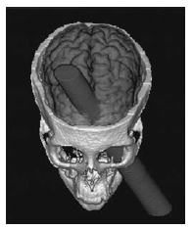
DISTURBANCE IN PERSONALITY AND BEHAVIOR
Phineas Gage – the first report of behaviour change following frontal lobe damage (Harlow, 1848, 1868).
In 1848, Gage was a 25-year-old construction foreman for a railroad company in New England.
Bizarre accident – a fine-pointed,
3-cm thick, 109-cm-long tamping iron
was hurled, rocket-like, through his
face, skull, brain, and then into the sky.
Notes:
Gage’s injury primarily affected the left frontal lobe from the medial orbital region upward to the precentral region.

Slide 66
Gage was momentarily stunned but regained full consciousness immediately thereafter; was able to talk and even walk with the help of his men.
Good physical recovery and many cognitive abilities remained intact.
However, gradually his personality appeared to change.
He became “profane, irreverent, capricious, lost all sense of responsibility, lost his job and thought nothing of contravening social niceties. His acquaintances remarked that he was ‘no longer Gage’”.
As Harlow (1868) observed, ‘the equilibrium between his intellectual faculty and animal propensities had disappeared’.
Notes:
contravening - violating

Slide 67
Drastic personality change, as in the case of Phineas Gage, generally
follows only large and usually bilateral frontal injuries.
A number of studies of frontal cortex damage suggest that damage to various parts of the cortex produce significant disturbances in personality (Stuss & Benson, 1986).
Brazzelli et al. (1994) suggest that ‘one of the possible consequences
of severe “frontal” derangement is social inadequacy’.

Slide 68
Autonoetic Awareness
Refers to autobiographical knowledge.
According to Tulving, autonoetic awareness makes it possible to
bind together the awareness of oneself as a continuous entity through time.
Patients with orbital frontal injury often lose this self-knowledge
and have difficulty in daily living.
Impairment in autonoetic awareness results in a deficit in the self-regulation of behaviour.
Notes:
Our behaviour is under the influence of our personal past experiences and life goals for the future such that we interpret the world in our daily life within our own frames of reference

Slide 69
The case of M. L., a salesman whose orbital frontal injury resulted from
a closed-head injury:
  M. L. noted that maintaining a close relation with his wife of 10 years was very difficult. “I have a hard time relating to my wife. I don’t know why
  I married this person. . . . I told myself I must have been happy, and
  they said I was.”

Slide 70
Emotional regulation and expression
Ventromedial prefrontal cortex implicated.
Difficulty understanding the emotional consequences of behaviour
(Stuss & Alexander, 2009).
Lability of mood and affect
Exhilaration
Depression
Anxiety
Irritability

Slide 71
Self-regulation and impulse control
Orbitofrontal cortex
Restlessness
Impulsivity
Disinhibition/lack of restraint
Lack of judgement
Risk-taking and rule-breaking
Dorsolateral cortex
Pseudo-depression
Apathy and indifference
Inertia
Decreased self-concern
Aspontaneity
Akinetic mutism
Poor motivation
Slowness in thinking
Notes:
(inability to move and speak)

Slide 72
Theory of Mind
Ability to infer the intentions and mental states of others (Leslie 1987).
Individuals with damage to the right hemisphere show impaired ToM but good reasoning, because damage to the right hemisphere causes impairments in social behaviour and thinking similar to those seen
in children with impaired theory of mind (Happe et al. 1999).
Frontal lobe patients were poorer than patients with damage to other
brain areas when making inferences about other people’s points
of view and at detecting deception (i.e. uncovering people’s real motives)(Stuss et al. 2001).
Notes:
The neuroimaging research on ToM suggests that the frontal lobe is involved in the ability to ascribe motives and beliefs to others. However, not all studies support this link between ToM performance and frontal cortex involvement.

Slide 73
Social Behaviour
Orbitofrontal damage.
Deficits in context dependent behaviour – choosing appropriate behaviours based on subtle changes in context, especially in social situations; notorious for making social gaffes.
Difficulty in using information from environmental cues (feedback) to regulate or change behaviour.
Notes:
Interaction with friends vs family/grandparents

Slide 74
Manifested as:
Decreased concern with propriety
Facetiousness
Egocentricity
Disinhibition
Inappropriate social interactions
Inappropriate comments, remarks, jokes.
Notes:
Blunder/faux pas
joking around, or treating serious subjects in a humorous way.
having little or no regard for interests, beliefs, or attitudes other than one's own; self-centered: an egocentric person; egocentric demands upon the time and patience of others

Slide 75
Sexual Behaviour
SITE OF LEISION | EFFECT
Frontal lesions | Altered libido and related sexual behavior
Orbital frontal lesions | Abnormal sexual behavior - reduced inhibitions (exhibitionism, public masturbation, etc.) Frequency of sexual behavior not affected
Dorsolateral lesions | Reduced sexual interest Can perform sexually if led through the activity “step by step.”

Slide 76
Two types of personality change clinically observed in frontal lobe patients depending on site of lesion (Blumer & Benson, 1975).
Two typical presentations – “frontal lobe personalities”
Orbitofrontal lesion – impulsivity and/or pseudo-psychopathy
Dorsolateral lesion – pseudo-depression
Notes:
two typical presenations - frontal lobe personalities

Slide 77
ORBITOFRONTAL LESION | DORSOLATERAL LESION
Pseudo-psychopathy Emotional lability – irritability, aggression Increased motor activity Impulsivity Poor judgement Inappropriate social behavior Lack of tact and restraint Immature behavior Coarse language Promiscuous sexual behavior Callous unconcern Boastfulness Grandiosity Obstinate, egocentric behavior | Pseudo-depression Apathy Indifference Decreased self-concern Little overt emotion Reduced motivation Loss of initiative Inertia Akinetic mutism Slowness in thinking Reduced verbal output Reduced sexual interest
Notes:
Descriptions of frontal lobe personality, therefore, cover a vast variety of symptomatology and there is considerable variation among patients.
REGIONS IMPLICATED IN MOOD DISORDERS and negative symptoms of schiz

Slide 78
ASSESSMENT OF PERSONALITY AND BEHAVIOR
Frontal Lobe Personality Scale
  Assesses premorbid vs current personality.
Hare Psychopathy Checklist
  Assesses adherence to social norms of interpersonal behaviours.
Faux Pas Test
  Assesses theory of mind and egocentricity.
Notes:
Instruments used to assess personality in frontal disorder patients yield data on premorbid versus current changes in personality and quantitative comparisons of behavioral disturbances among different frontal lobe disorders, but none of the instruments has proven useful for predicting real-life performance.

Slide 79
Limitations of assessment
Few standardized neuropsychological tests are useful for assessing frontal lobe patients.
Not all frontal patients are the same.
Some symptoms of frontal lobe injury, such as loss of self-regulation
of behaviour, are not easily assessed by a neuropsychological test.
Significant dissociations exist between test and real-life performance.

Slide 80
Many individual case studies show how neuropsychological assessment is not that sensitive to everyday difficulties in
behaviour following brain injury.
Many patients with frontal lobe damage perform well on standardized neuropsychological and frontal tests, despite significant difficulty
in planning and organizing daily life.
Shallice and Burgess (1991): the design of neuropsychological tests
makes finding frontal-cognitive impairments especially difficult.
Tests devised to take in the multiple demands on the patient
in everyday life show that frontal patients have extreme difficulty
in performing these tasks (Shallice & Burgess, 1991).
Notes:
because the patient is normally presented with a single, well-defined problem that has to be solved in a short period of time, often prompted by the examiner. This is very different from the planning and cognition necessary in day-to-day life.

Slide 81
Many individual case studies show how neuropsychological assessment is not that sensitive to everyday difficulties in
behaviour following brain injury.
Many patients with frontal lobe damage perform well on standardized neuropsychological and frontal tests, despite significant difficulty
in planning and organizing daily life.
Shallice and Burgess (1991): the design of neuropsychological tests
makes finding frontal-cognitive impairments especially difficult.
Tests devised to take in the multiple demands on the patient
in everyday life show that frontal patients have extreme difficulty
in performing these tasks (Shallice & Burgess, 1991).
Notes:
because the patient is normally presented with a single, well-defined problem that has to be solved in a short period of time, often prompted by the examiner. This is very different from the planning and cognition necessary in day-to-day life.

Slide 82
FRONTAL LOBE SYNDROME
PROGNOSIS

Slide 83
Despite scoring normally on conventional tests of general cognitive ability, patients require 24-hour care and supervision.
This is because, although their intellectual functions are retained, they
are unable to apply these cognitive skills appropriately in their everyday life.
Such patients may compromise their own safety by leaving the stove lit, the gas turned on, or taps running, or failing to lock doors.
They fail to plan meals or to shop, and may also neglect their own hygiene and fail to change or wash their clothes.
Activities are impulsively conceived but rarely carried out, or if begun not completed.

Slide 84
According to Beaumont (2008), frontal lobe syndrome is difficult to rehabilitate due to lack of insight and awareness on the part of the patients.
Had they been aware, they would no longer have the problem, retaining the cognitive abilities to perform the relevant tasks appropriately.
It is this lack of insight, and the inability to appreciate the consequences of their actions, that makes the frontal lobe syndrome so disabling and leads to a substantial, and lifelong, need for care
and supervision.
Notes:
CAN LOOK PERFECTLY NORMAL BUT REALLY STRUGGLE IN THEIR DAILY LIVING
damage = wide variety of symptoms = affects most areas of daily functioning

Slide 85
REFERENCES

Slide 86
Beaumont, J. G. (2008). Introduction to neuropsychology. Guilford Press.
Chow, T. W. (2000). Personality in frontal lobe disorders. Current psychiatry reports, 2(5), 446-451.
Kolb, B., & Whishaw, I. Q. (2009). Fundamentals of human neuropsychology. Macmillan.
Godefroy, O. (2003). Frontal syndrome and disorders of executive functions. Journal of neurology, 250(1), 1-6.
Goldberg, E., & Bougakov, D. (2005). Neuropsychologic assessment of frontal lobe dysfunction. Psychiatric Clinics, 28(3), 567-580.
Hoffmann, M. (2013). The human frontal lobes and frontal network systems: an evolutionary, clinical, and treatment perspective. ISRN neurology, 2013.

Slide 87
Martin, G. N. (2006). Human neuropsychology. Pearson education.
Pirau, L., & Lui, F. (2018). Frontal Lobe Syndrome. In StatPearls [Internet]. StatPearls Publishing.
Small, D. M., Bender, G., Veldhuizen, M. G., Rudenga, K., Nachtigal, D., & Felsted, J. (2007). The role of the human orbitofrontal cortex in taste and flavor processing. Annals of the New York Academy of Sciences, 1121(1), 136-151.
Stuss, D. T., & Alexander, M. P. (2009). Frontal lobe syndrome. In L. R. Squire (Ed.), Encyclopedia of neuroscience (pp. 375-381). Elsevier.
Stuss, D. T., & Benson, D. F. (1984). Neuropsychological studies of the frontal lobes. Psychological bulletin, 95(1), 3.

